Slide 1
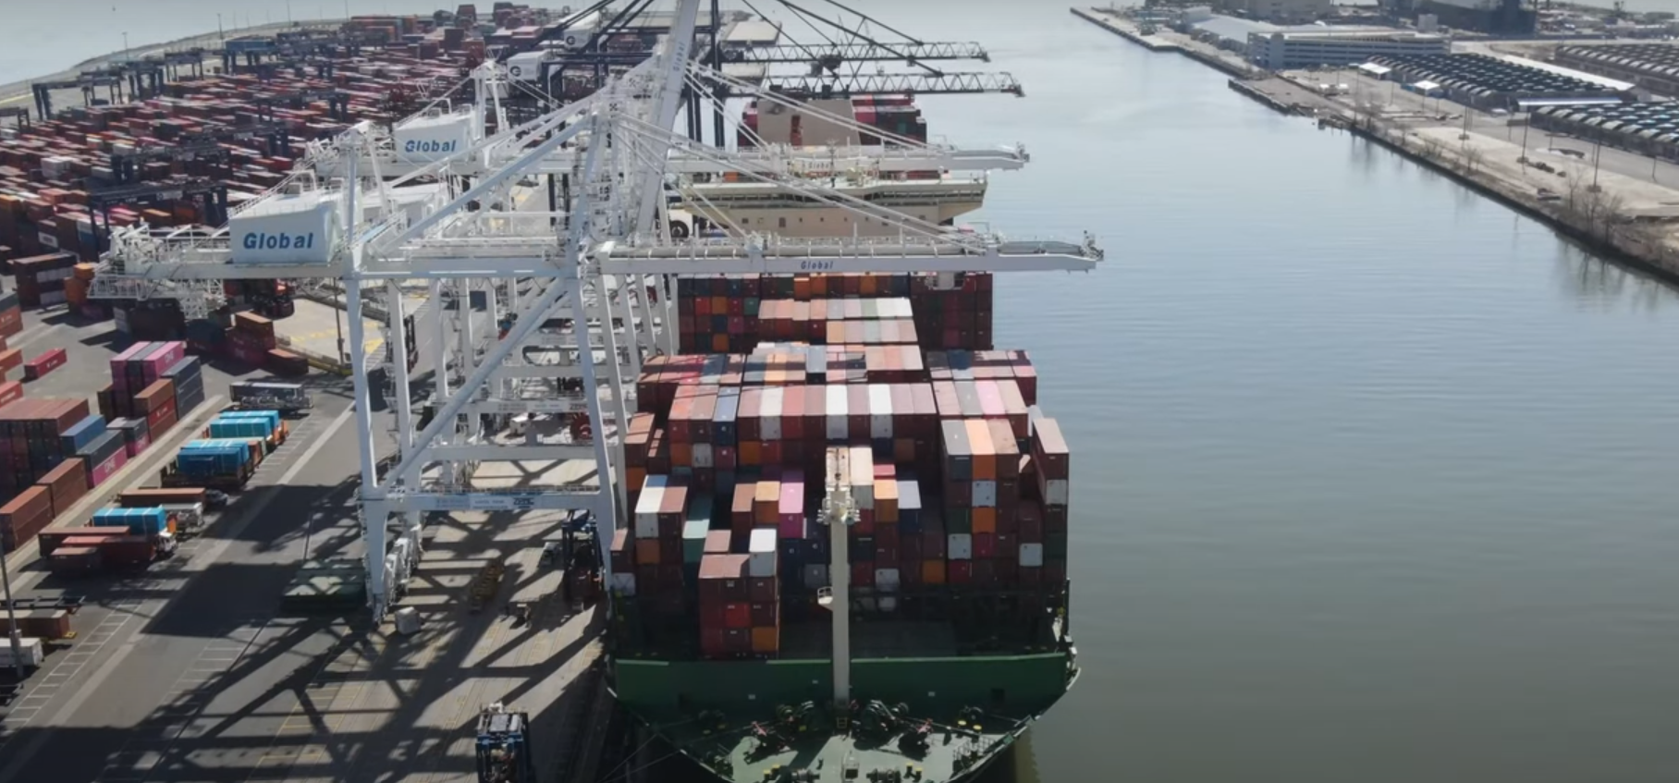
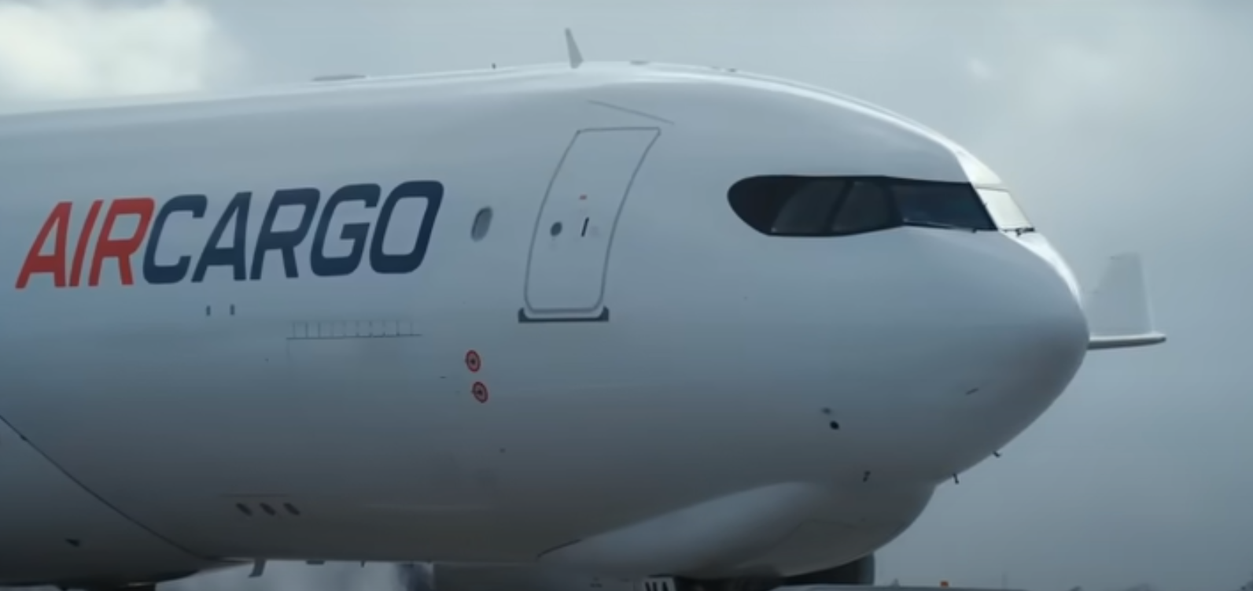
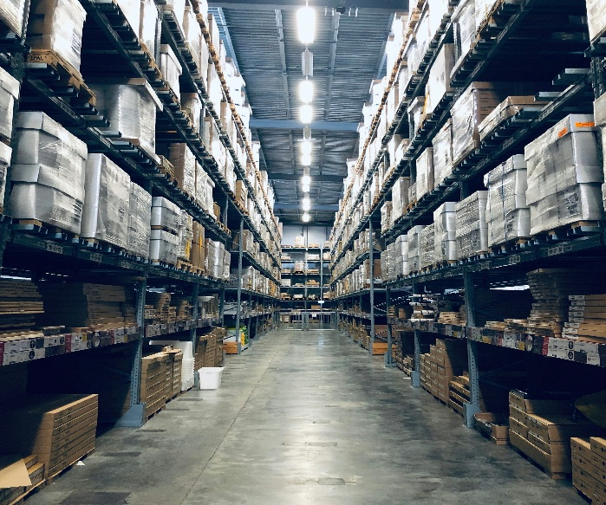
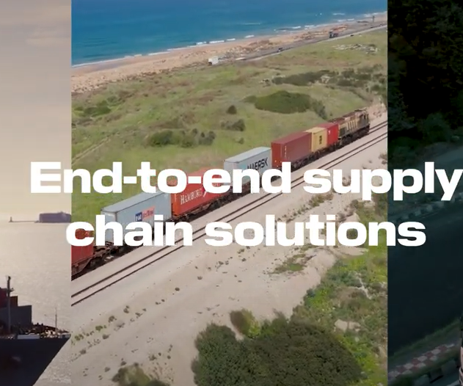
INTRODUCING A FRYTBOX WORLD WIDE OF FREIGHT FORWARDING And logistics
With flexibility, transparency and on-ground expertise anywhere you need it, FRYTBOX Freight Forwarding is the better way to get your goods factory floor to customer door – across countries. Built on our comprehensive network of Freight Forwarding, international transportations and our deep logistics experience, FRYTBOX Forwarding is accelerating trade to help you grow your business.,
FRYTBOX
LOGISTICS
FREIGHT FORWARDING YOU CAN TRUST
We look at our customers' evolving supply chain needs and seamlessly design logistics solutions that address their challenges and identify growth opportunities.
WE EVOLVING EACH DELIVERY POSSIBLE WITH FRYTBOX
Our Freight Forwarding offering combines expert logistics and local insights across our global network with state-of-the-art digital solutions. This delivers a service that empowers your business with trust and assurance. Our end-to-end service expedites the flow of your goods, drawing from decades of experience and investments in both established and emerging markets, creating fresh global opportunities for your business.
Offering transparent pricing, complete cargo visibility and customised flexibility, FRYTBOX WORLD WIDE Logistics and Freight Forwarding simplifies your path to trade.
Our Values guide how we deliver
AT FRYTBOX We’re here to help simplify global trade for your business, moving your goods - however big or small – to the places they need to be. We partner with you, listen to your needs and take action, connecting and collaborating with our network and partners across the whole journey, so you can focus on running your business with successful delivery’s
In today’s ever-changing trade landscape, you require a freight forwarding and Logistics partner that instils confidence in the journey of your goods.
FRYTBOX Freight Forwarding offering combines expert logistics and local insights across our global network
with state-of-the-art digital solutions. This delivers a service that empowers your business with trust and assurance.
02

Slide 2




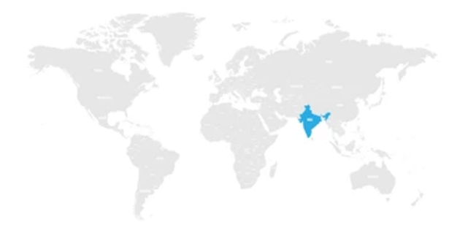
FRYTBOX SOLUTION
FRYTBOX
WHY FRYRTBOX
Freight Competitiveness with Large Volume
Enjoy the simplicity of dealing with a team who understand your needs and can tailor a solution just for you, We’ve designed our services to address the challenges you face and give you an advantage.
FRYTBOX LINKS WORLD WITH CUSTOMERS
FRYTBOX provides is a global supply chain logistics company that provides ocean and air freight forwarding, warehousing, distribution services, return of cargo, International transportation, pick up, Last-Mile, customs clearance and supply chain management – a seamlessly connected suite of supply chain solutions that delivers superior value, reliability, and expertise. wherever our valuable customers want. Customers are always enabled to book in real-time, search schedule and check cargo status through FRYTBOX integrated platform.
Global Network and Operation Expertise
FRYTBOX worldwide network allows us to serve you globally while understanding local nuances for a personalized experience. Our team possesses the knowledge and skills to handle any logistics challenge effectively.
Customer - Centric Approach & Cooperation
Your satisfaction is our priority. We tailor our services to match your unique needs and provide responsive customer support.
YOUR INDUSTRIES
Automotive and Energy
IT System
Real-time visibility up to Last-Mile
We use the latest digital tools for freight forwarding, giving customer
We are connecting your vehicles from your factory floor to your customer’s door or for last mile wherever you need. Innovative, reliable and tailored solutions for energy transport logistics, whenever and wherever needed.
The FRYTBOX Advantage
At FRYTBOX Freight Forwarding, our unwavering commitment to operational excellence and customer partnerships enables us to easily handle any challenges that arise. Our global freight forwarding network spans the globe, providing the local insights, flexibility, cutting-edge technology, analytical prowess and expert knowledge needed to meet your distinctive cargo demands. Whether navigating shifting trade dynamics or staying competitive with pricing, we keep you ahead of the curve.
Industrial & Aerospace
Tailor-made solutions to manage complex demands and make supply chains leaner and more agile. And Dedicated teams to move your defence and aerospace cargo around the globe in the safest fashion.
Healthcare and Chemical
FRYTBOX NETWORK
Biopharma, Medical Devices, Diagnostics & labs, Hospital and Home Care – FRYTBOX experienced and dedicated team, seamlessly design global and local solutions to deliver the best possible care for your patients.
Technology & Retail
Transport to warehouse, distribution centre or direct-to-store so goods can reach the retailers directly. End-to-end, integrated and reliable supply chain solutions to link production sites with distribution channels across the world.
The Best Freight Forwarding and Logistics Partner, FRYTBOX Links Customers and the World

Slide 3

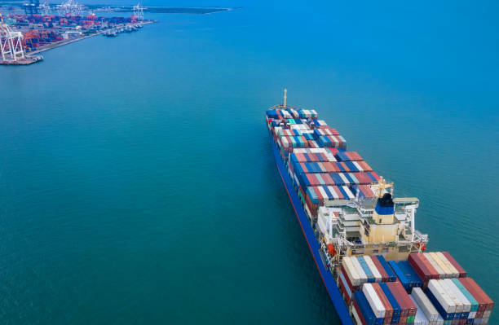

FRYTBOX SERVICES
FRYTBOX PRODUCTS
BASIC PREMIUM EXPRESS
The Modes of Transport
FRYTBOX Tailored Shipping Services to Meet Your Business Needs By providing the right combination of freight or cargo shipping, logistics services, and supply chain technology, FRYTBOX worldwide can help businesses streamline their operations and optimize their supply chains.
AIR FREIGHT
Your shipments will reach their destination quickly, safely, and in perfect condition
PROJECT LOGIISTICS
Find a right-sized solution for challenging routes and heavy or oversized cargo.
SEA FREIGHT
LAND TRANSPORT
Give us your freight. It could be bulk, packaged, temperature-controlled, out-of-gauge, or hazardous FRYTBOX will ensure dependable delivery of your freight.
When cost matters and time is not an issue
CUSTOMS CLEARANCE
WAREHOUSING & VALUE-ADDED SERVICES
Frytbox puts its expertise to use to handle all of your warehousing needs
Ease your paperwork and let us deal with customs requirements
AIR FREIGHT LOGISTICS
Enjoy the simplicity of dealing with a team who understand your needs and can tailor a solution just for you and We’ll take your business around the world and to new heights. Our robust air freight network and team of experts will ensure that your goods get where they need to be, on time and in mint condition
Air cargo Service
Sea –Air / Air- Sea Logistics
Dangerous Goods
Time defined cargo Handling
Over Dimensional cargo handling
Temperature Controlled Cargo
Perishable Goods
SEA FREIGHT LOGISTICS
We’re here to ensure your cargo reaches the right place, at the right time, in the most economical way – without the need to compromise on quality or reliability. Through the extensive equipment and consolidation options of ocean freight, we work closely with you to find budget-friendly, end-to-end ocean cargo shipping solutions, tailored to your specific needs
Full Container Load (FCL)
Less than Container Load (LCL)
Temperature Controlled Ocean Freight
Ocean Bulk
Dangerous Goods
Project Cargo and Non-Containerized Shipment Solution
Value-Added Ocean Freight Forwarder Services
Features & Advantages
Features & Advantages
We Create unique solutions to meet supply chain needs while focusing on economies of scale and targeted transit time
Gain access to our global network and take advantage of our close relationships with prime carriers partners
Draw upon our versatile industry experience for dedicated solutions tailor-made for your special requirements
Diverse worldwide Ocean schedules
We are at your service 24/7 to make sure your goods reach their destinations around the world in the best possible transit time and at cost-efficient routes.
We go the extra nautical mile by providing you with the latest updates from the current location of your shipment to handling customs brokerage, quality control and inspections

Slide 4
FRYTBOX SERVICES
FRYTBOX PRODUCTS
BASIC PREMIUM EXPRESS
PROJECT LOGISTICS AIR/SEA
Our Project & Energy Services team offers unique solutions for oversized and heavy-lift freight. While a massive or heavy load, such as a press, presents a special set of challenges, it still has one thing in common with every other piece of cargo: it needs to get there. And our project Cargo Team has deep experience in all modes of transport. They also draw on local hands-on expertise to handle the most complex project cargo, from concept all the way through execution
We offer a variety of core and value-added services: “ Over-dimensional cargoes, Heavy lift, Project logistics, Full/part ocean breakbulk chartering, Complex multi-modal moves, Route studies, Cargo inspection, Loading/unloading supervision’’
Renewable Energy
Power and Industrial
Mining
Aerospace and Defense
Oil and Gas
ROAD LOGISTICS FREIGHT SERVICE
FRYTBOX Inland Network Services is a time-definite platform that supports all products and business needs for cargo movement by Inland, including cost optimization, secure and scalable capacity, damage free transportation and on-time performance, ultimately enhancing all products and allowing FRYTBOX to exceed our customers' expectations.
Domestic FTL
Domestic LTL
Domestic and cross-border trucking
Contract pick-up and delivery services
Heavy haulage solutions, including high-payload tasks
Over-dimensional transport
Temperature-controlled goods
Features & Advantages
Features & Advantages
Charter Services of full and part charter of ocean vessels and aircraft charters
Reducing lead time and efficient SCM
Exclusive smart visibility service for Smoother road transportation leading to efficient last-mile deliveries and higher customer satisfaction
Various types of transportation service including Port movement / ICD to ICD / CFS to CFS/ Door to Door / Airport to Airport / Store to Stroe
Take advantage of our expert handling for project and sensitive cargo, ensuring safe and reliable transport for your most critical shipments
We provide you dedicated on-site staff and complete life cycle support to optimise your project logistics from door to door .
CUSTOMS CLEARANCE
Looking for seamless customs clearance solutions in India? As a customs broker, FRYTBOX helps importers and exporters process declarations through customs and associated Customs House agencies. We prepare required documentation, calculate import duties ,export drawback and other taxes on behalf of the importers and arrange for delivery.
Updating of the latest developments in Foreign Trade Policy and customs notification
Free Consultation on the Export & Import policy and Procedures / Import and export clearance
Duty drawback, EPCG, Advance License, SEZ application
Pre-shipment authorisation and pre-clearance
Export document preparation
SVB Clearance, Bonding and De-Bonding cargo
Electronic connection to customs/electronic filing
Consulting services and advice
Immediate visibility of your shipments through our track and trace ICEGATE system
Warehousing & Value-Added Services
We understand the importance of your warehouse and contract logistics facilities in ensuring your supply chain’s agility and efficiency. Our warehouses in key locations around the world keep your product flow stable and reliable. We continually enhance our capabilities to drive operational efficiency and excellence.
We have vast experience in a large array of value added services from co-packing, kitting, localisation, labelling, testing, tagging, and so much more. We are able to provide the flexibility and customisation you need.
Consolidation Services
Order Fulfillment
Ecommerce
Pick & Pack
Kitting
Value-added Services
Storage (short and long-term)
Inventory control and management
Features & Advantages
Features & Advantages
Our experienced team assists clients with all export/import registrations, duty exemptions, and DGFT formalities, ensuring seamless service at competitive price
Expert preparation and verification of all required documents, providing assistance with regulatory compliance and seamless paperwork processing.
Advising various Trade Schemes Options provided by Govt that the client can take advantage
Our warehouses are equipped with advanced security measures, including 24/7 surveillance cameras and strict access controls, to protect your inventory and ensure peace of mind.
Our customizable WMS facilitates real-time product tracking, adapts to emerging needs, and flexible adjustments to meet your business needs.
Supporting FTWZ handling and 3PL outsourced partner.

Slide 5
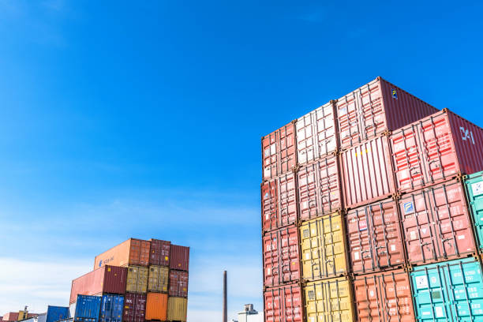
FRYTBOX WORLDWIDE LOGISTICS
Are you looking for a partner that can help you with land transport, air and ocean freight, contract logistics, and trade fair and specialized transports? We're there for you in your region. Just use our location search feature to find an office or facility near you:
www.frytbox.com
FRYTBOX is at your side
We come up with the right integrated logistics solution for every requirement across the Global
Get in touch with us!
Global Corporate Office
FRYTBOX WORLDWIDE LOGISTICS PRIVATE LIMITED
No 5AC, 961, 2nd Floor, HRBR Layout 1st Block,
Bank Avenue Colony, Banaswadi,
Bengaluru, Karnataka 560043, India
Email : info@frytbox.com

